Slide 1



SMART INDIA HACKATHON 2025
TITLE PAGE
Problem Statement ID - SIH25044
Problem Statement Title - Al-Powered Crop Yield Prediction and Optimization
Theme - Agriculture, FoodTech & Rural Development
PS Category - Software
Team ID - S4_03
Team Name - TEAM_AGROSENSE

Slide 2
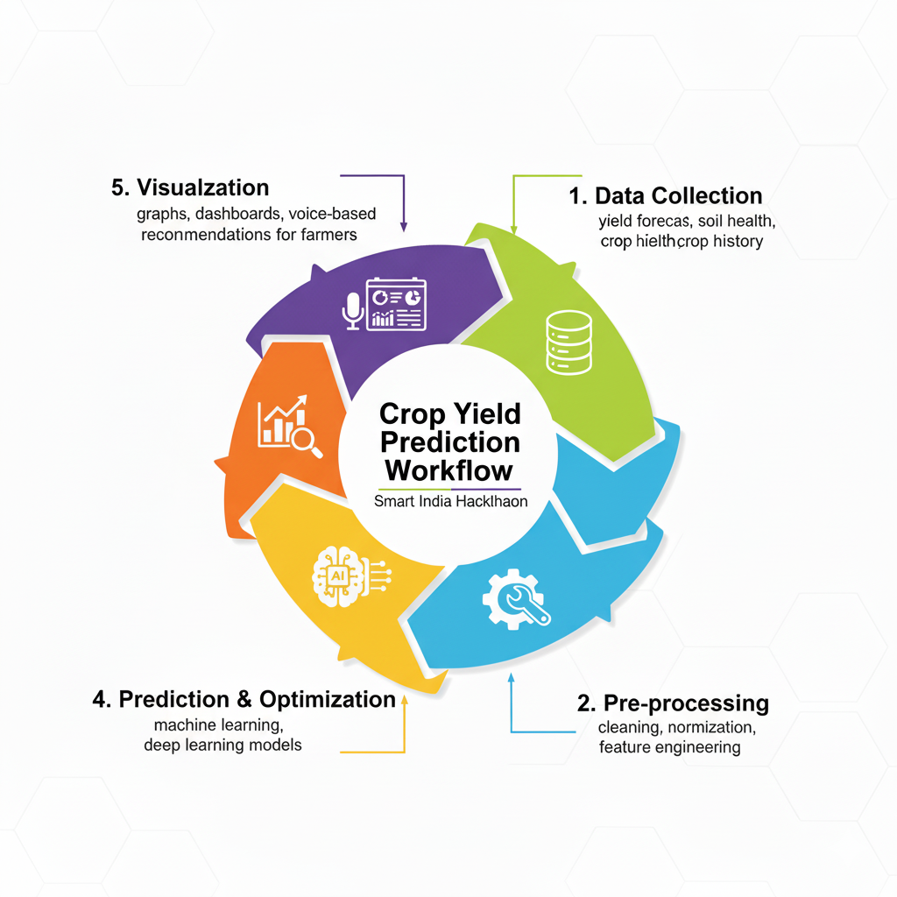
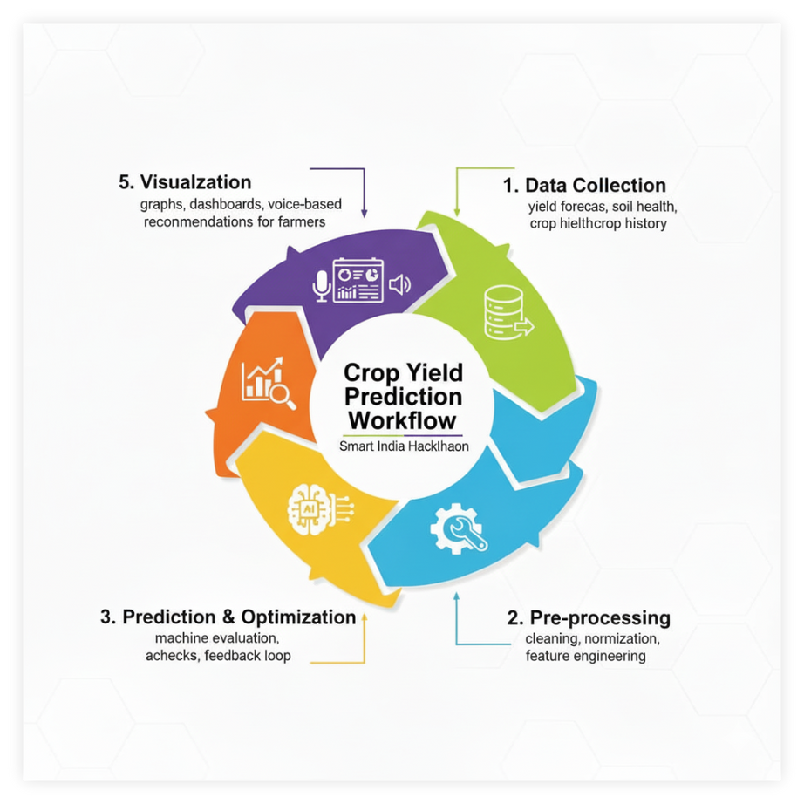
AGROSENSE
TEAM_AGROSENSE
AI-powered Crop Yield Prediction using Machine Learning (ML), Deep Learning (DL), and Predictive Analytics trained on weather, soil health & historical agricultural data.
Smart Farming Advisory System providing real-time, data-driven recommendations for precision irrigation, optimized fertilization & AI-based pest management.
Increased Productivity – Enables farmers to achieve 10%+ yield improvement while ensuring resource optimization & cost reduction.
Innovation – Cloud-integrated ML/DL models & weather APIs for continuous learning and accuracy. Calculations based on sustainable values.
Uniqueness – Multilingual, mobile-first interface ensuring last-mile accessibility for small & marginal farmers, no monetization, user friendly and no expertise needed.
Recommendation on various factors not just yield.
Scalability – Cross-platform (Web + Mobile App), adaptable to diverse crops & regional conditions, community is built( so discussion forums)
Future Scope & Implementation-
🎙Voice Input (NLP + Speech Recognition) – Conversational AI in regional languages.
📸Image Processing (Computer Vision) – Disease & pest detection using CNN-based models.
📊Market Intelligence (Big Data Analytics) – Supply-demand forecasting, profit prediction & pricing insights.
🏛GovTech Integration (APIs) – Personalized government schemes, subsidies & compliance guidelines via secure user authentication.
@SIH Idea submission- Template
2

Slide 3






















TECHNICAL APPROACH
TEAM_AGROSENSE
Technologies Used-
Frontend – HTML, CSS, JavaScript, Bootstrap
Backend – Python & supported libraries, FastAPI
Data- Kaggle, Huggingface, Supabase for data analytics
Database – MongoDB / PostgreSQL / SQLite
APIs – OpenStreetMap (GPS → State), ML/DL model API (Yield & Soil Prediction)
Methodology & Process:
Inputs Collected: GPS, NPK values, crop type, fertilizer used, and area.
Process Flow:
1./get-state: GPS is converted to state.
2./predict-yield: Estimates yield and extra fertilizer needed.
3./soil-health: Computes the Soil Health Index (SHI) and NPK requirements.
4.Final Response: A JSON is sent to the frontend for a user-friendly display.
@SIH Idea submission- Template
3

Slide 4
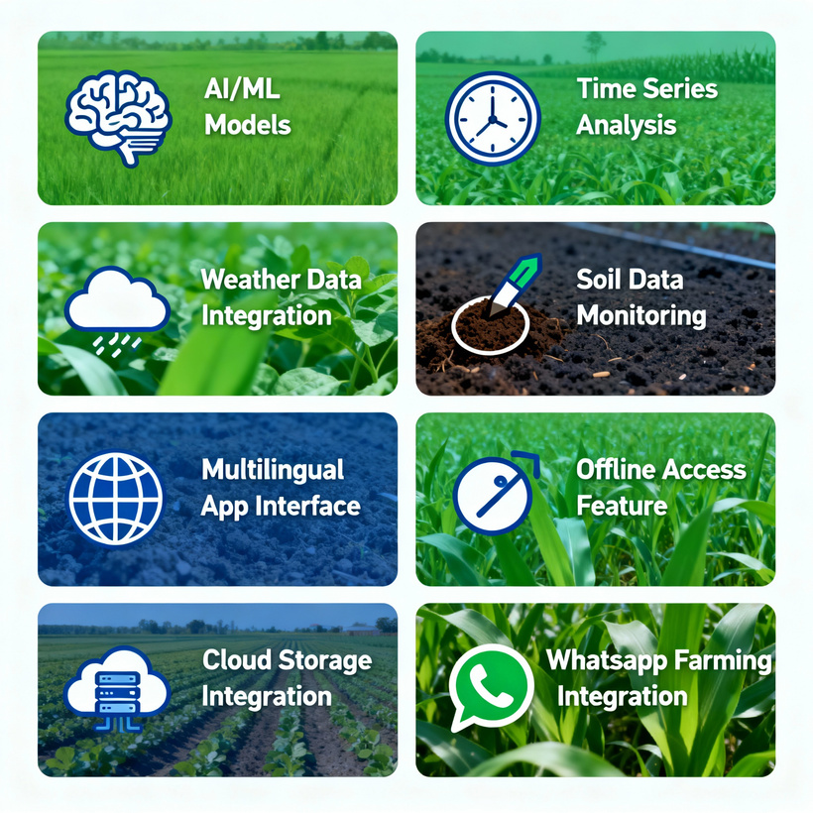
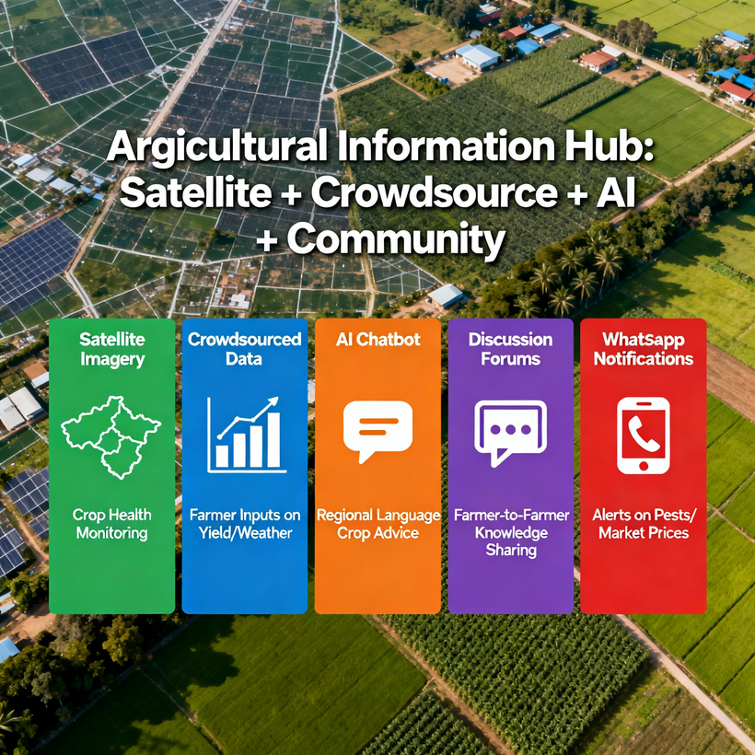
FEASIBILITY AND VIABILITY
TEAM_AGROSENSE
Strategies
Integrate satellite imagery + crowdsourced farm data for Big Data-driven insights
Discussion forums integrating LangChain and LLMs help farmers solve problems.
LLMs, Agentic AI & chatbot based advisory in regional languages.
Real time report summaries, government schemes and guideline updates via Whatsapp.
Feasibility Analysis
Time series, Proven AI/ML models (KNN, RandomForest, XGBoost,Regression, CNNs, RNNs), publicly available weather & soil Data.
Multilingual interface for farmer accessibility.
Low-cost, scalable solution using open-source datasets & cloud computing.
Available offline app, using Internet to improvise predictions and recommendations further.
Whatsapp for seamless communication & simplicity.
Challenges & Risks
Incomplete / inconsistent agricultural data (data quality issue)
Rural connectivity gaps affecting real-time analytics
Climate variability impacting prediction accuracy
Farmer adoption barriers – trust & digital literacy issues
@SIH Idea submission- Template
4

Slide 5
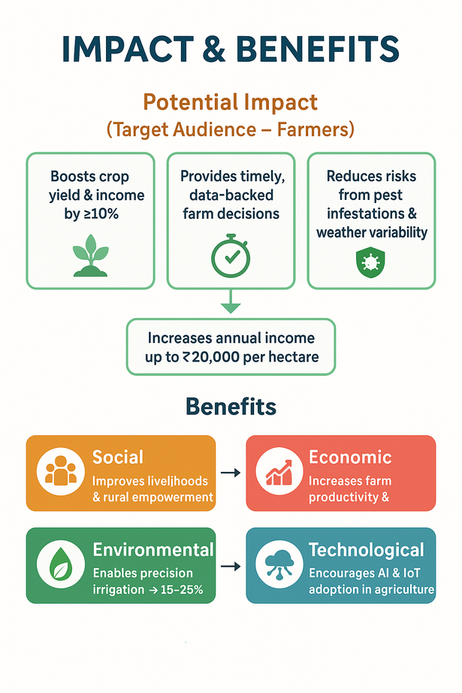
IMPACT AND BENEFITS
TEAM_AGROSENSE
Potential Impact (Target Audience – Farmers)
Boosts crop yield & income by ≥10% through AI-driven predictive analytics.
Provides timely, data-backed farm decisions (irrigation, fertilization, pest control).
Reduces risks from pest infestations & weather variability using real-time monitoring.
Increases annual income up to ₹20,000 per hectare, empowering small-scale farmers.
Benefits of the Solution
Social Impact
Improves livelihoods & rural empowerment.
Enhances food security & reduces dependence on guesswork.
Economic Impact
Increases farm productivity & profitability.
Reduces input costs via optimized fertilizer & irrigation.
Environmental Impact
Enables precision irrigation → 15–25% water savings. Soil nutrient optimization
Promotes sustainable agriculture with minimal resource wastage.
Technological Impact
Encourages AI & IoT adoption in agriculture.
Integrates Machine Learning, Big Data Analytics, Cloud Computing, and Smart Farming tools.
@SIH Idea submission- Template
5

Slide 6
RESEARCH AND REFERENCES
TEAM_AGROSENSE
REFERENCE LINKS
RESEARCH LINKS
https://farmonaut.com, monetization
https://kisansuvidha.gov.in-limited interface, no recommendation
https://www.jiokrishi.com-with IOT
https://www.cropin.com-Complex interface
https://www.kaggle.com
https://huggingface.co
https://supabase.com
https://claude.ai/new
https://ieeexplore.ieee.org/stamp/stamp.jsp?arnumber=10965701
https://www.sciencedirect.com/science/article/pii/S2405844024168673
https://www.data.gov.in/resource/crop-water-and-irrigation-water-requirement-under-surface-and-drip-irrigation-methods
https://ieeexplore.ieee.org/document/10689872
https://www.ijfmr.com/papers/2024/6/29913.pdf
@SIH Idea submission- Template
6

